Slide 1
RENEWABLE WASTE ENERGY PRODUCT
DHOK WAZIRAN NAGROTA

Slide 2
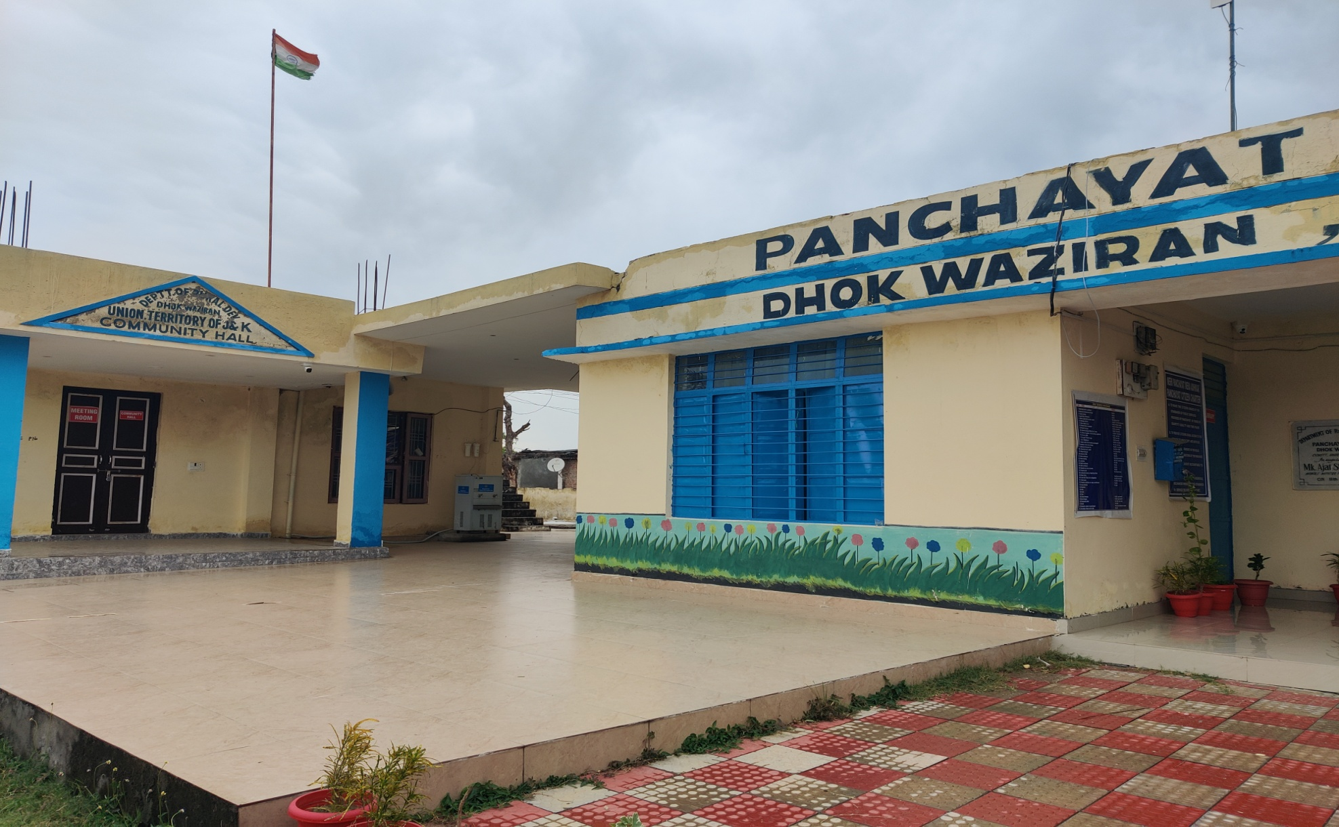
BRIQUETTE

Slide 3
composition
20% of rural disposed off garbage consists of :
1.waste collected by broom
2.News paper soiled or used in packing/wrapping
3.Wood saw dust, branches, dry discarded leaves
4.Grass waste, with cowdung or otherwise
5.Egg trays waste Board boxes
6.Rise husk/ Stubble left in fields to burn
7.Board waste ( packaging material) courier material

Slide 4
Stubble waste
Deteriorating of soil biological health environmental problem.
Pollution of air, environment hazard
If burnt fire penetrates into soil killing wildlife, insects, waste of energy, soil health, biodiversity.
Asthma, lung failure, heart problem.
Green house effects.

Slide 5
What it is / benefits
Compressed Block.
Combustible, biomass material, sawdust, wood chips, Chula coal waste. All discarded material.
Provide more stable burn, maintain temperature, has less hand holding than charcoal.
Reduces garbage, Lot cheaper than coal, Reduction in volume of garbage, saves space, lower disposal cost.
High revenue, Employment generation.

Slide 6
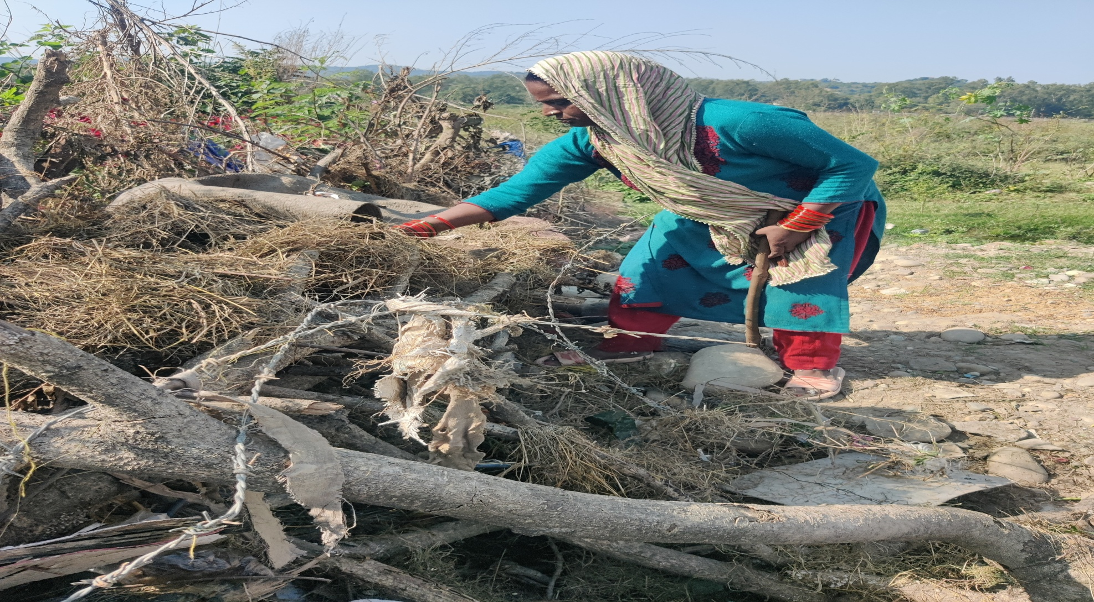
Rot wood waste

Slide 7
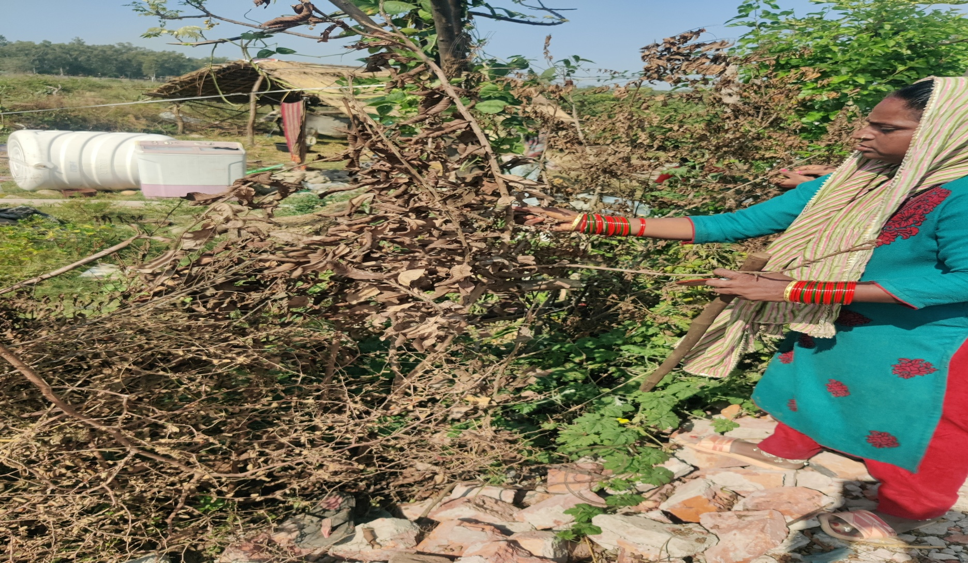
Discarded branches

Slide 8
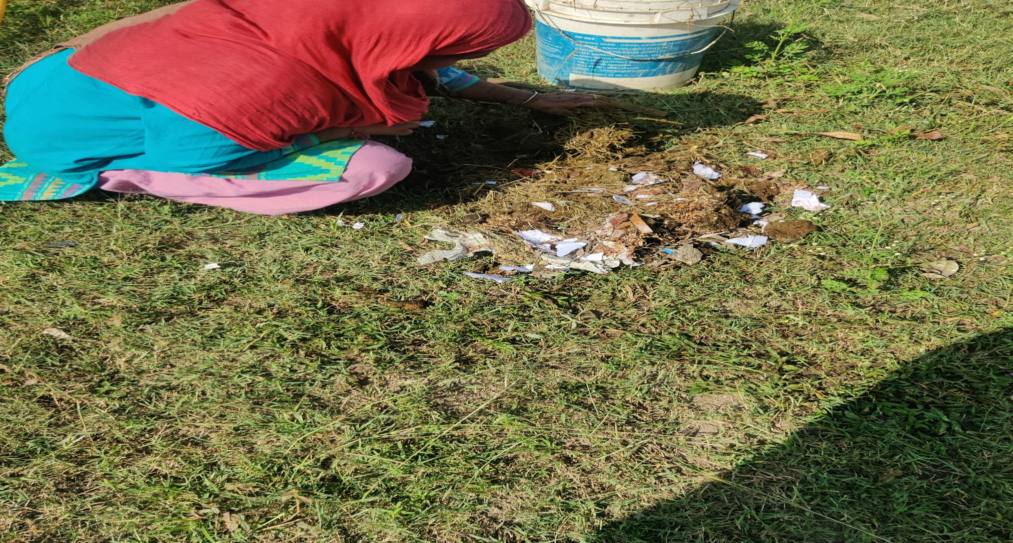
Cowdung household waste

Slide 9
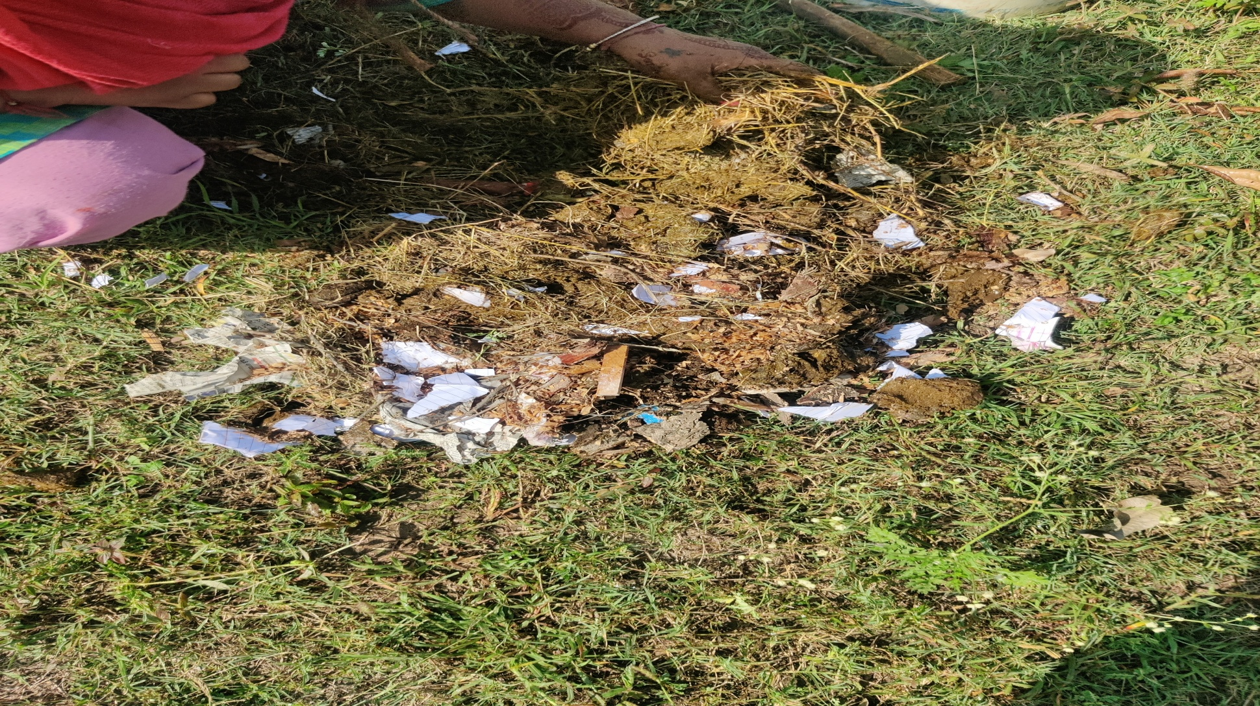
Mixing all together

Slide 10
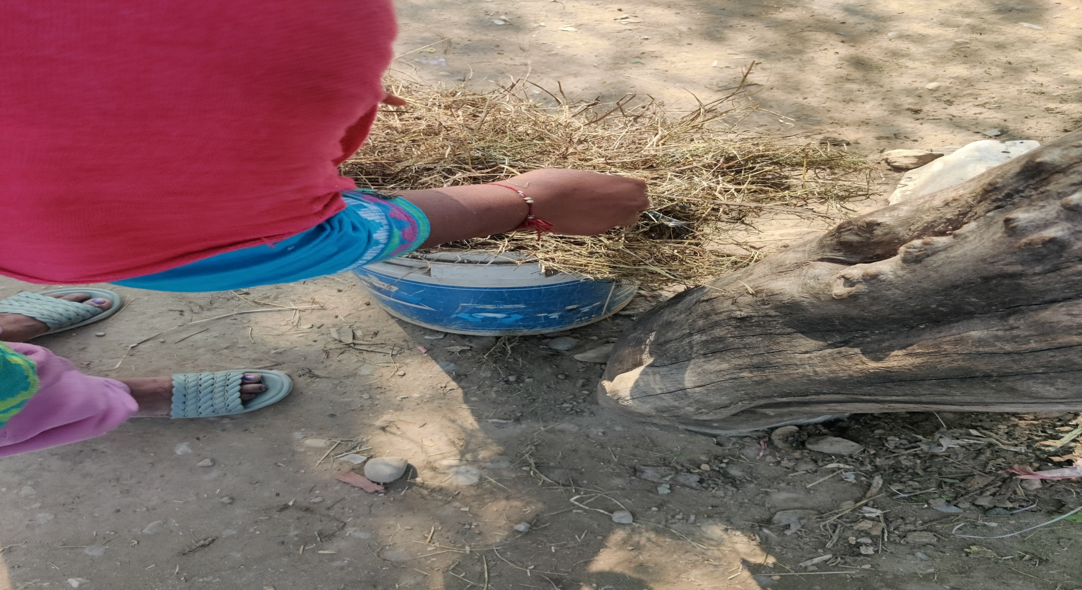
Dustbin broom waste

Slide 11
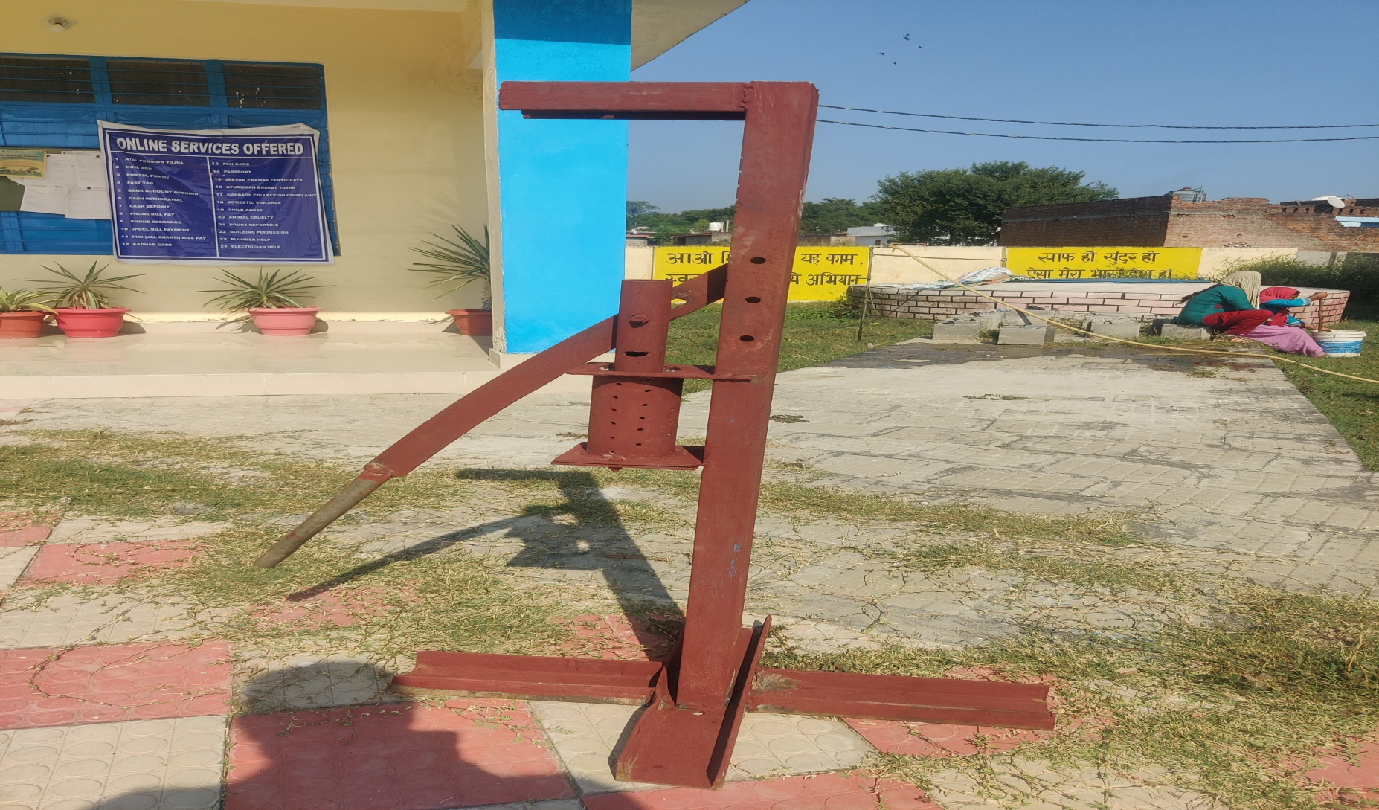
Indigenous machine model – rocket science for garbage disposal

Slide 12
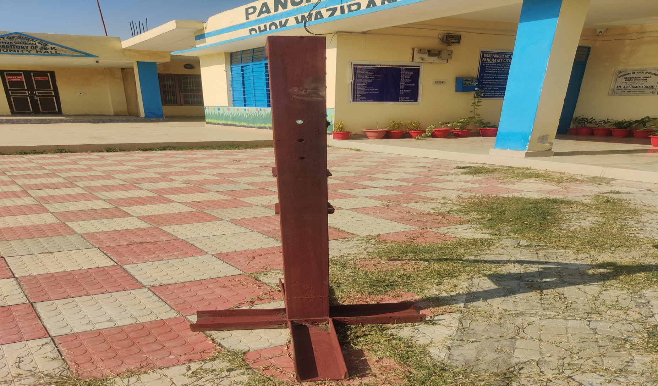
Idea incorporated from one used in making savian

Slide 13
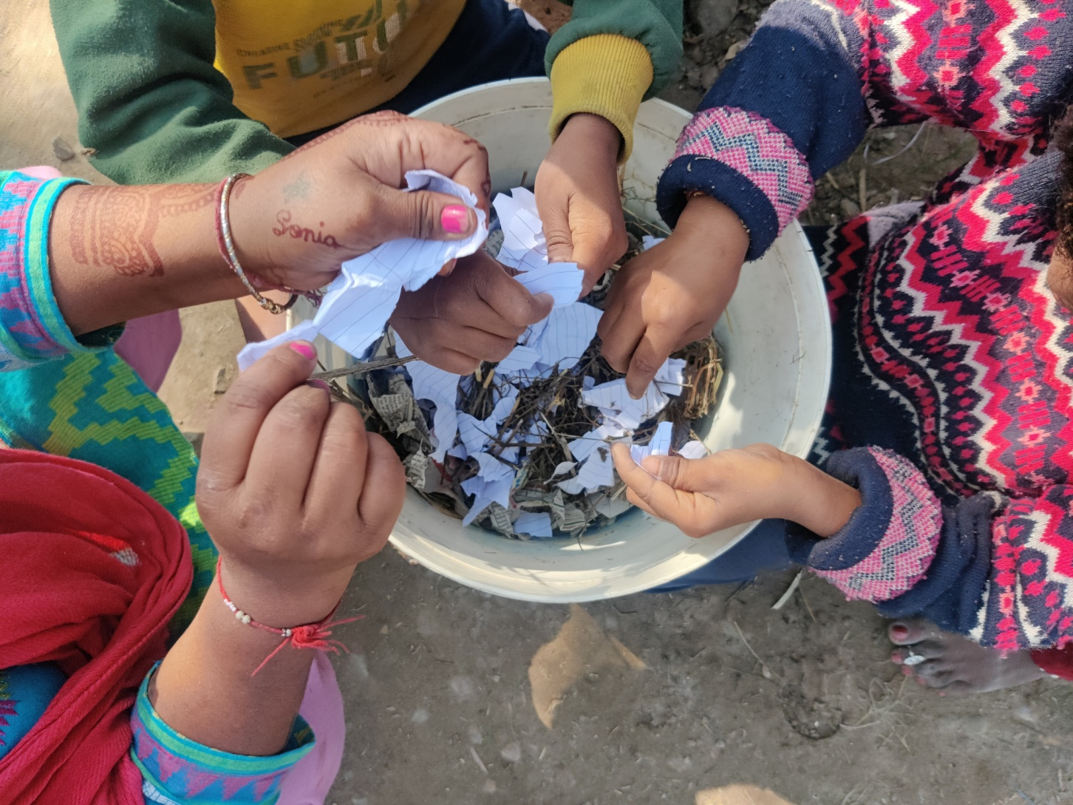
Rags to riches collecting waste

Slide 14
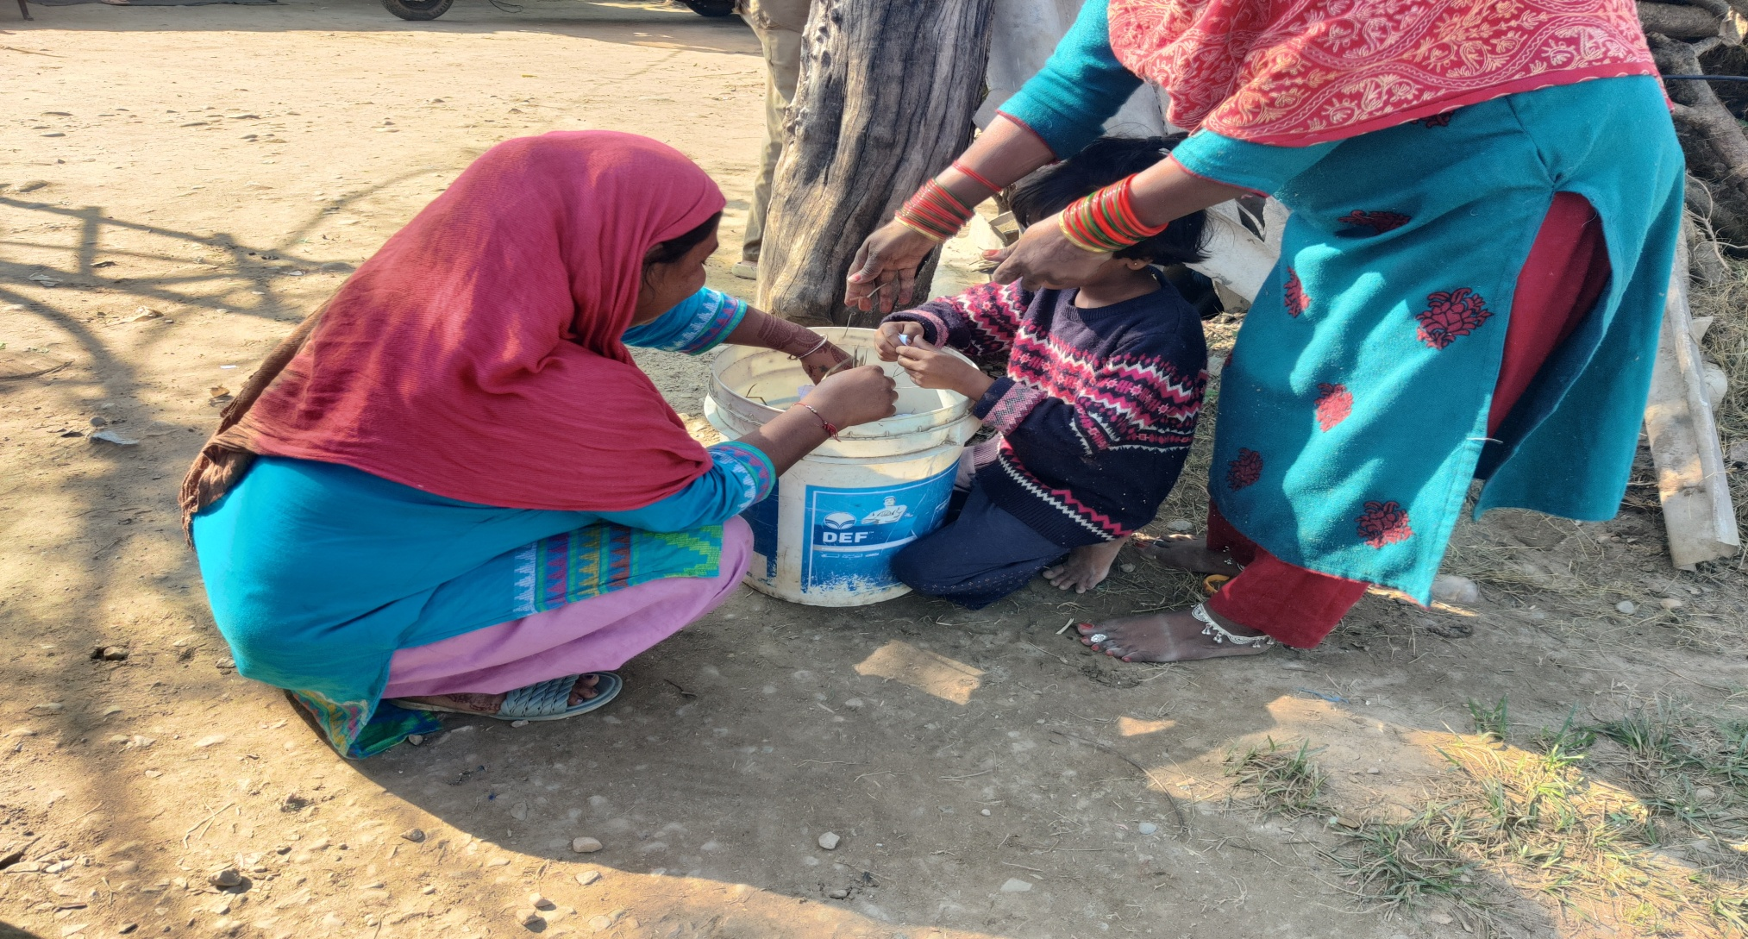
Catch em young helping elders collecting waste

Slide 15
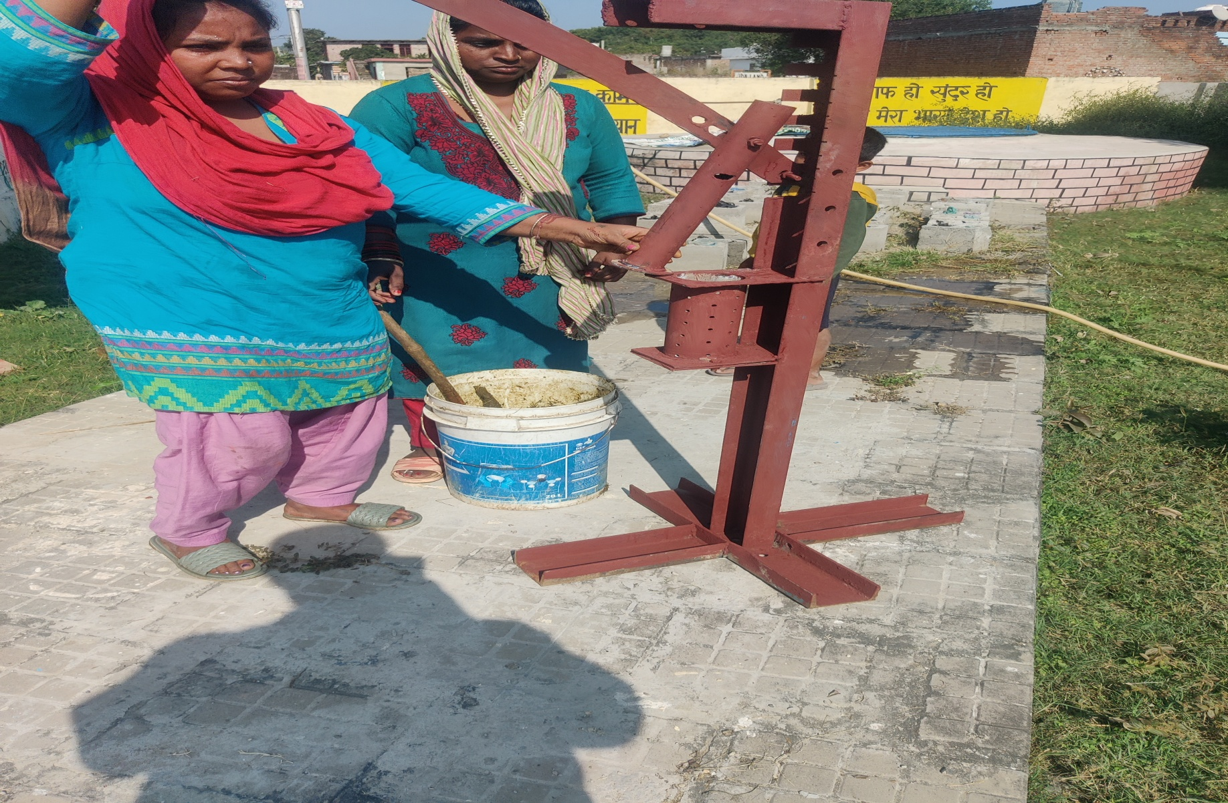
All set n go mixture ready

Slide 16
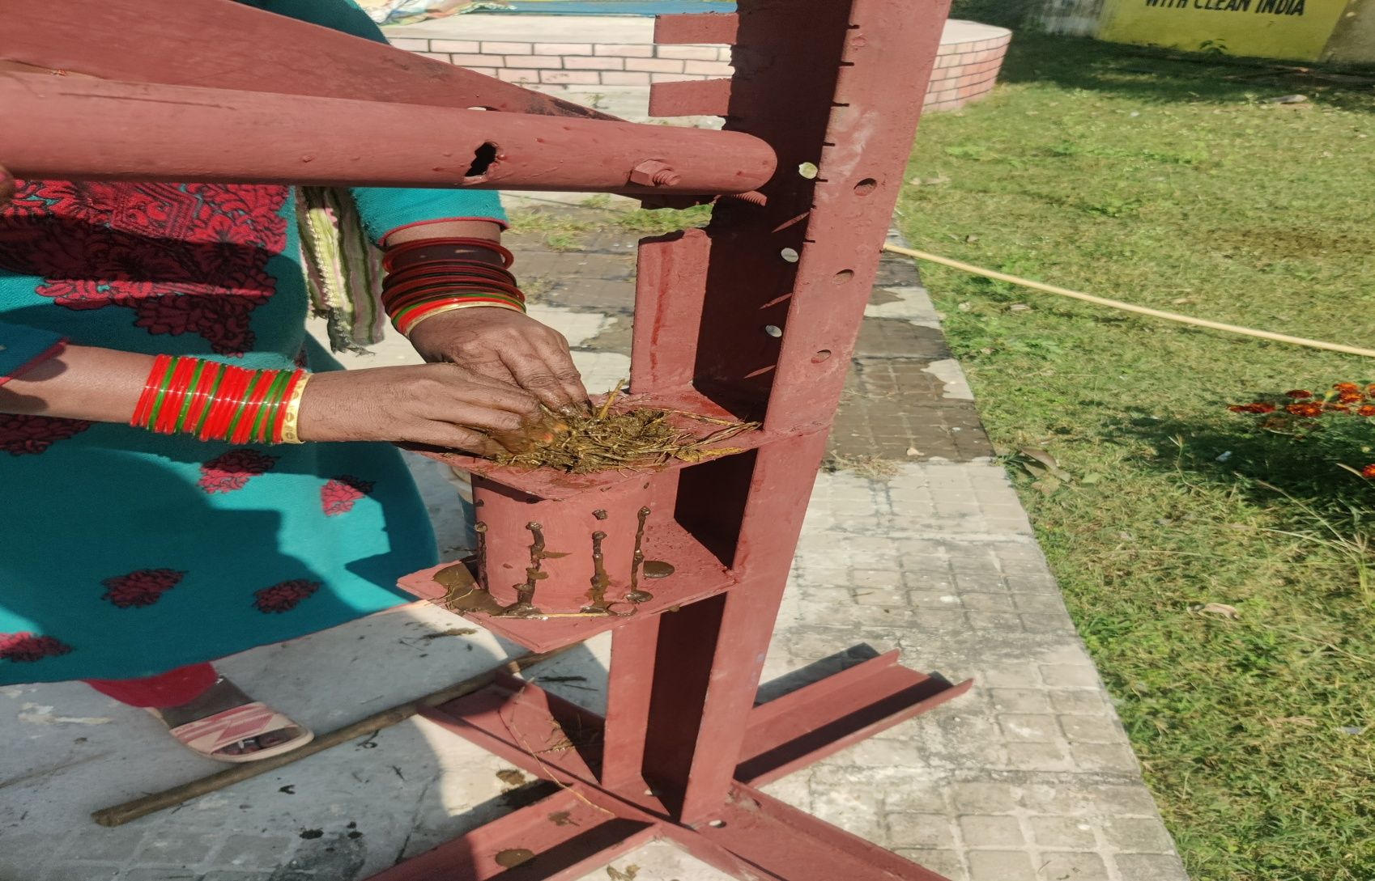
Putting wet mixture in chamber

Slide 17
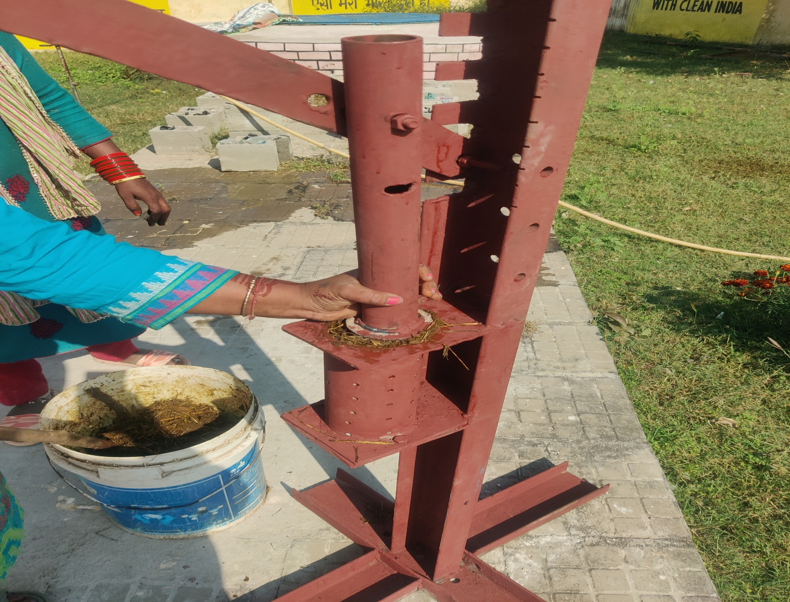
Applying pressure to raw material

Slide 18
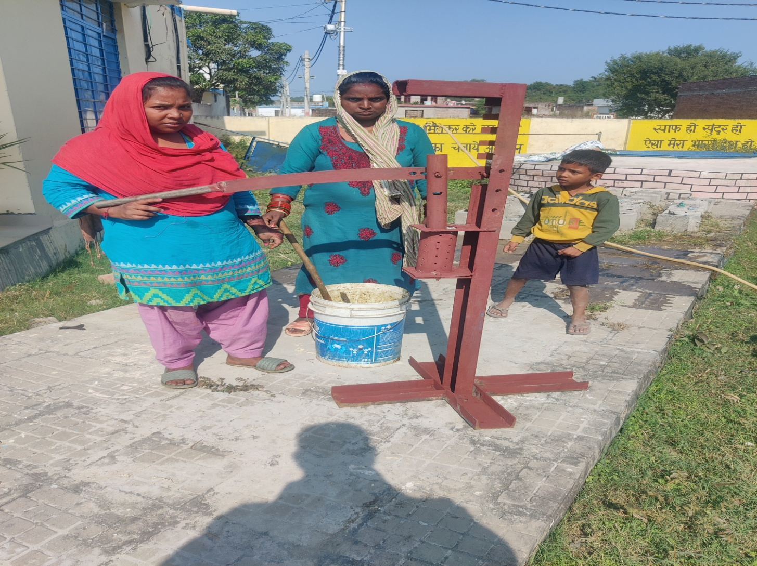
A little wait

Slide 19
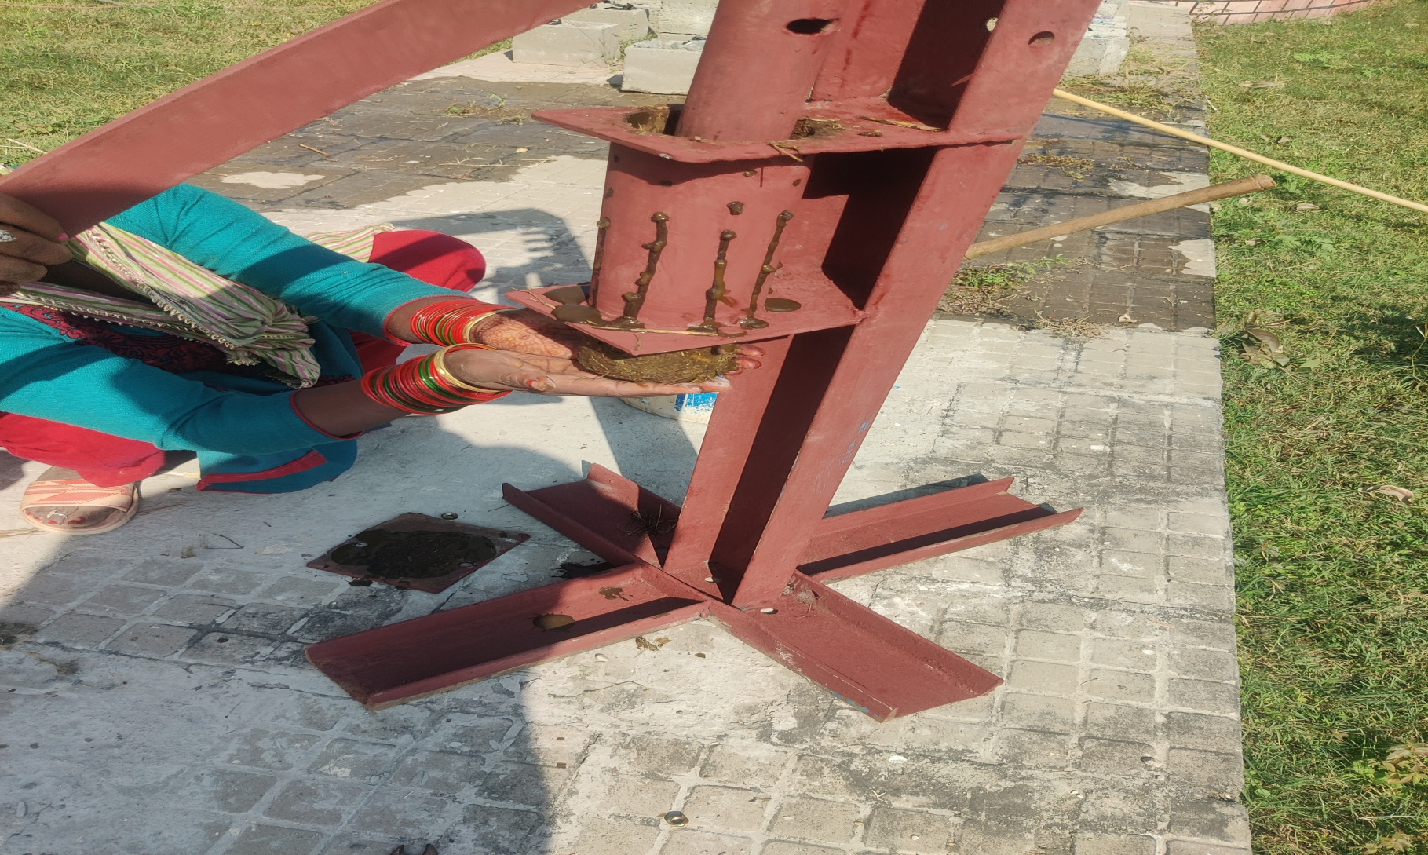
Final product coming out

Slide 20
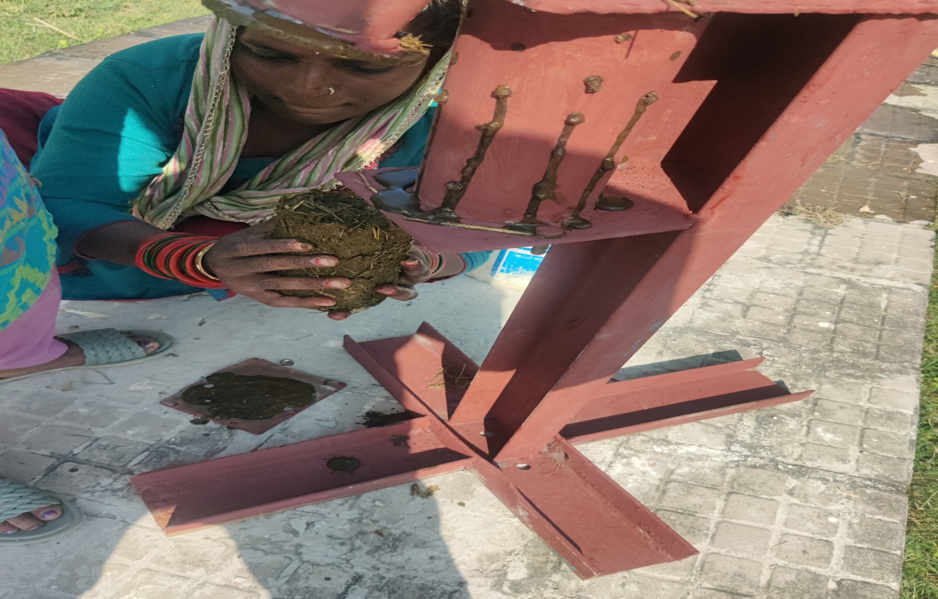
Brown gold

Slide 21
Comparative table
Coal BRIQUETTE
Have to buy mostly free available
No constant energy flow constant energy flow
Hard to make easy to make
Does not reduce garbage reduces garbage
No substitute Bio fuel
Not renewable Renewable energy
Does not reduce volume Reduces volume of garbage
High investment cost Low investment cost
Production expensive low cost production
Harmful gases no gas emission
Rs.20/- per KG Rs.10/ per KG

Slide 22
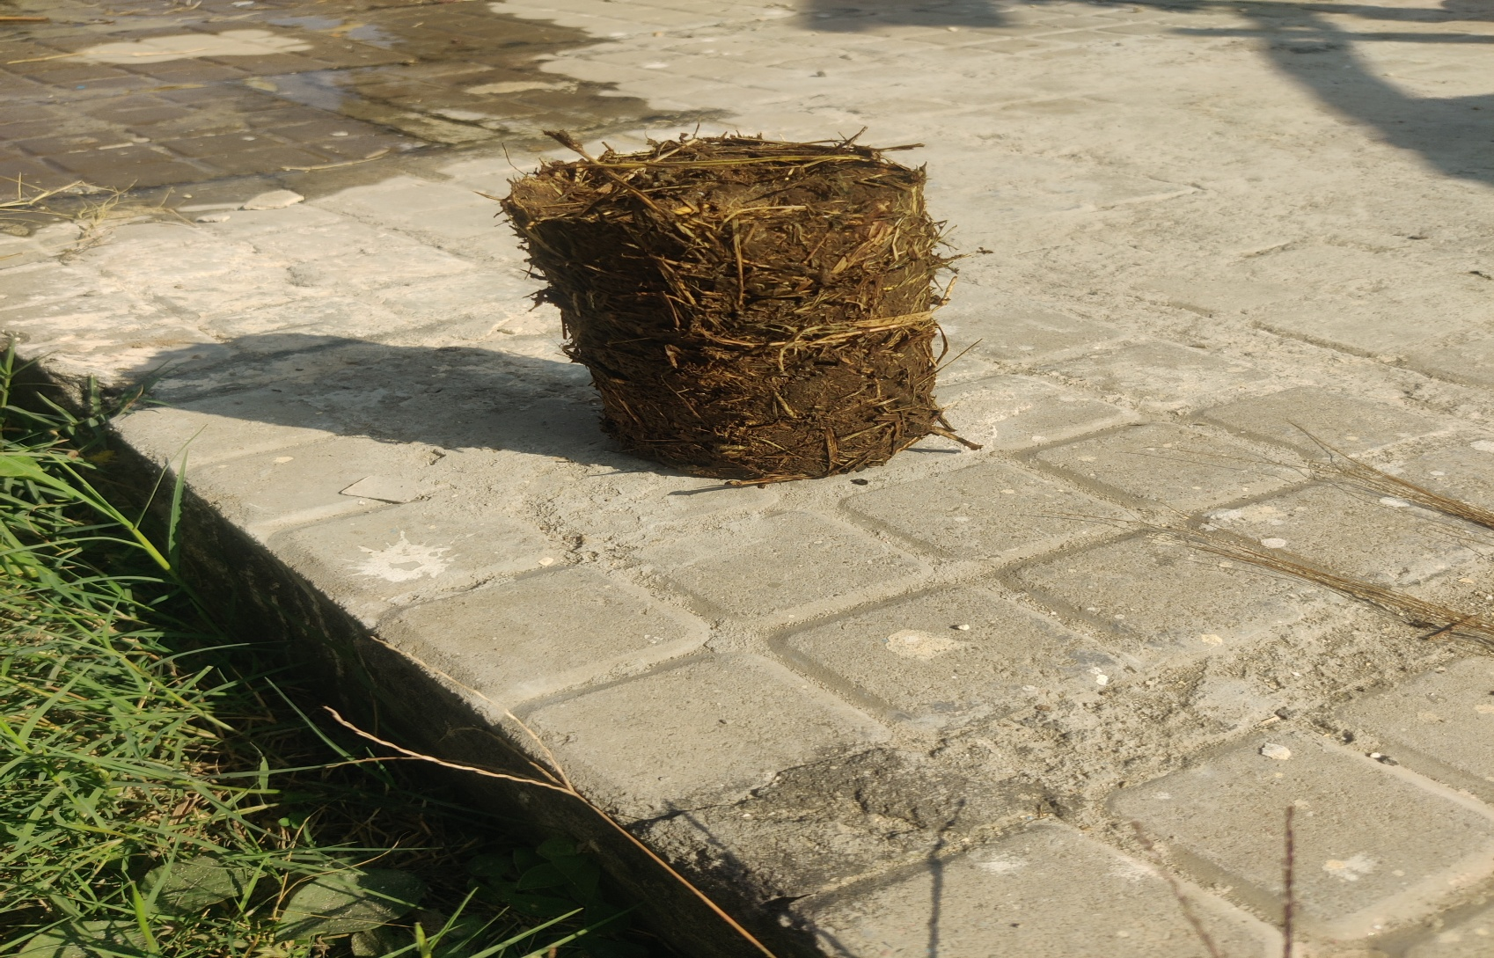
Final product household INDUSTRIAL use and application

Slide 23
uses
Industrial furnace use
Substitute for wood in rural homes
Saves wood
Replacement / Substitute for coal
Pure for sure
Can be used for all purposes
Heating use instead of coal or wood
Will reduce garbage by 20 percent
Generates Employment
Low cost production
Cheap by 50% as compared to coal or wood

Slide 24
Industrial furnace use
Substitute for wood in rural homes
Saves wood
Replacement / Substitute for coal
Can be used for all purposes
Will reduce garbage by 20 percent
Generates Employment
Low cost production
Cheap by 70% as compared to coal or wood
If on an average one household uses one tree in a year, in one Block approximately 1000 trees would be saved in a year.

Slide 25
FINAL CALL
WE REDUCED GARBAGE PROVIDED EMPLOYMENT MADE MONEY
SO CAN YOU.

